Slide 1
TRAFFIC VOLUME ESTIMATION USING MACHINE LEARNING
TEAM MEMBERS
ASHIKA.S
SRILEKHA.A

Slide 2
PRESENTATION OUTLINE
Introduction
Objectives
System Architecture / Ideation Map
Module Implementation
Conclusion & Future work
References

Slide 3
INTRODUCTION
Traffic congestion has been one of the major issues that most metropolises are facing despite measures being taken to mitigate and reduce it.
The safe and time-efficient movement of the people and goods is dependent on Traffic flow, which is directly connected to the traffic characteristics.
Early analysis of congestion events and prediction of traffic volumes is a crucial step to identify traffic bottlenecks, which can be utilized to assist traffic management .
We will train and test the data with these algorithms.
From this best model is selected and saved in . pkl (Pickle) format.
Once the model is saved, we integrate it with flask application
We will be using Regression algorithms such as Linear Regression, Decision tree, Random forest, and xg boost to predict the count of traffic volume

Slide 4
METHODOLOGY
REQUIREMENTS:
Python
Python Web Frame Works
Python For Data Analysis
Python For Data Visualization
Data Pre-processing Techniques
Machine Learning
jypter notebook / VSC
spyder

Slide 5
OBJECTIVES
You’ll be able to understand the problem to classify if it is a regression or a classification kind of problem.
You will be able to know how to pre-process/clean the data using different data pre-processing techniques.
You will able to analyze or get insights into data through visualization.
Applying different algorithms according to a dataset and based on visualization.
You will be able to know how to find the accuracy of the model.
You will be able to know how to build a web application using the Flask framework.

Slide 6
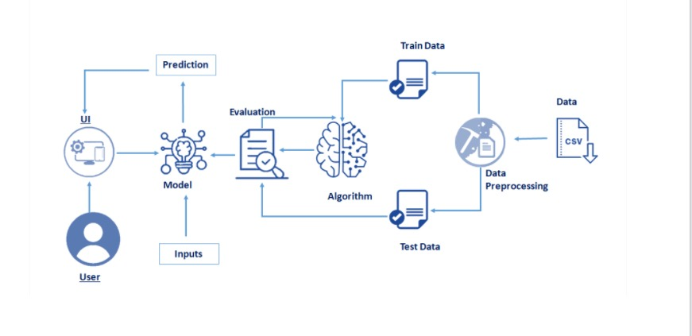
SYSTEM ARCHITECTURE/IDEATION MAP

Slide 7
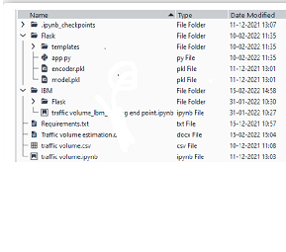
PROJECT IMPLEMENTATION
PROJECT STRUCTURE

Slide 8
Flask files consist of template folder which has HTML pages, app.py file and .pkl files which are used for application building
IBM folder has flask files and scoring endpoint.ipynb- model training code file.
We need the model which is saved and the saved model in this content is Traffic volume. Pkl
Templates folder which contains index.HTML file, chance.HTML file, noChance.HTML file.
Scale.pkl for scaling, encoder.pkl file for encoding the categorical data, imputer.pkl file for filling out the missing values

Slide 9
DATA PREPROCESSING
IMPORTING NECESSARY LIBRARIES
It is important to import all the necessary libraries such as pandas, NumPy, matplotlib.
Numpy- It is an open-source numerical Python library. It contains a multi-dimensional array and matrix data structures. It can be used to perform mathematical operations on arrays such as trigonometric, statistical, and algebraic routines.
Pandas- It is a fast, powerful, flexible and easy to use open source data analysis and manipulation tool, built on top of the Python programming language.
Seaborn- Seaborn is a Python data visualization library based on matplotlib. It provides a high-level interface for drawing attractive and informative statistical graphics.
Matplotlib- Visualisation with python. It is a comprehensive library for creating static,animated, and interactive visualizations in Python
Sklearn – which contains all the modules required for model building.

Slide 10
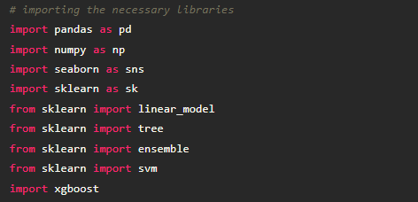

Slide 11

IMPORTING THE DATASET:
Let’s load a .csv data file into pandas usingread_csv() function.We will need to locate the directory of the CSV file at first (it’s more efficient to keep the dataset in the same directory as your program).
If your dataset is in some other location, Then
Data=pd.read_csv(r”File_location/datasetname.csv”)

Slide 12
Our Dataset weatherAus.csv contains the following Columnsoliday - working day or holiday
Temp- temperature of the day
Rain and snow – whether it is raining or snowing on t
Weather = describes the weather conditions of the day
Date and time = represents the exact date and time of the day
Traffic volume – output column
The output column to be predicted is Traffic volume.Based on the input variables we predict the volume of the traffic. The predicted output gives them a fair idea of the count of traffic

Slide 13
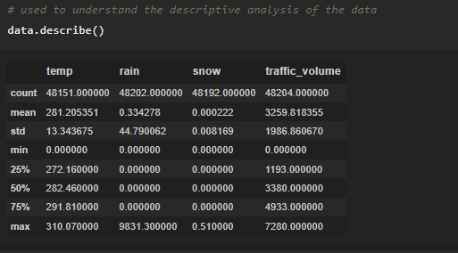
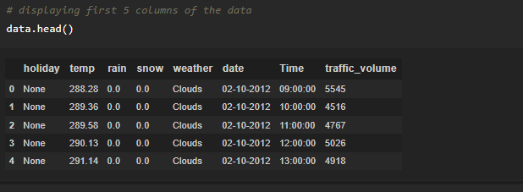
ANALYZE THE DATA
head()method is used to return top n (5 by default) rows of a DataFrame or series.
describe() method computes a summary of statistics like count, mean, standard deviation, min, max, and quartile values.

Slide 14
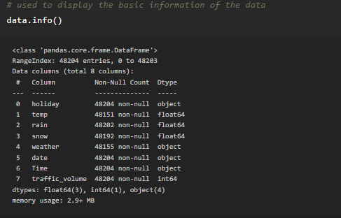
From the data, we infer that there are only decimal values and no categorical values. info() gives information about the data - paste the image here.

Slide 15
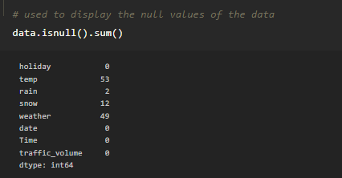
HANDLING MISSING VALUES
The Most important step in data pre-processing is dealing with missing data, the presence of missing data in the dataset can lead to low accuracy.
Check whether any null values are there or not. if it is present then the following can be done.

Slide 16
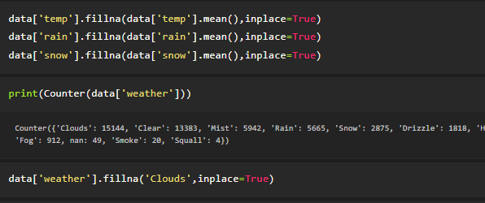
We are using mean and mode methods for filling the missing values
Columns such as temp, rain, and snow are the numeric columns, when there is a numeric column you should fill the missing values with the mean/median method. so here we are using the mean method to fill the missing values.
Weather column has a categorical data type, in such case missing data needs to be filled with the most repeated/ frequent value. Clouds are the most repeated value in the column, so imputing with clouds value.

Slide 17
DATA VISUALIZATION
Data visualization is where a given data set is presented in a graphical format. It helps the detection of patterns, trends and correlations that might go undetected intext-based data.
To visualize the dataset we need libraries called Matplotlib and Seaborn.
·The Matplotlib library is a Python 2D plotting library that allows you to generate plots, scatter plots, histograms, bar charts etc.
Let’s visualize our data using Matplotlib and seaborn library. Before diving into the code, let's look at some of the basic properties we will be using when plotting.

Slide 18
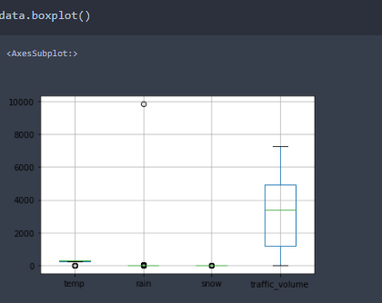
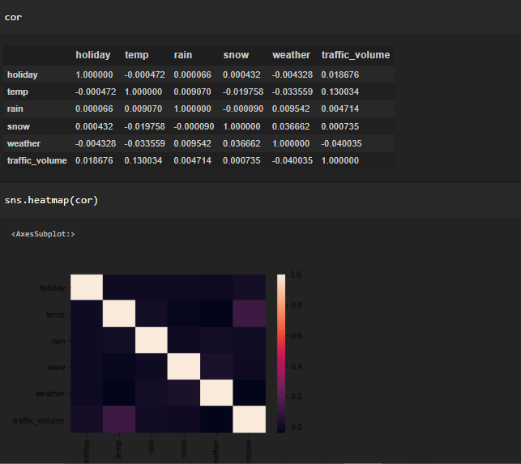
data.corr() gives the correlation between the columns
Correlation is a statistical term describing the degree to which two variables move in coordination with one another.
If the two variables move in the same direction, then those variables are said to have a positive correlation. If they move in opposite directions, then they have a negative correlation. -

Slide 19

SPLITTING THE DATASET INTO DEPENDENT AND INDEPENDENT VARIABLE
In machine learning, the concept of the dependent variable (y) and independent
variables(x) is important to understand. Here, the Dependent variable is nothing but output in dataset and the independent variable is all inputs in the dataset.
With this in mind, we need to split our dataset into the matrix of independent variables and the vector or dependent variable. Mathematically, Vector is defined as a matrix that has just one column.
To read the columns, we will use iloc of pandas (used to fix the indexes for selection) which takes two parameters — [row selection, column selection].
Let’s split our dataset into independent and dependent variables.
y = data[traffic_volume] - independent
x = data.drop(traffic_volume,axis=1)

Slide 20
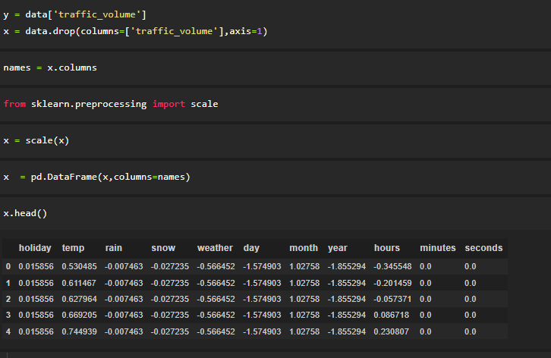
FEATURE SCALING:
Feature scaling is a method used to normalize the range of independent variables or features of data.
After scaling the data will be converted into an array form
Loading the feature names before scaling and converting them back to data frame after standard scaling is applied

Slide 21
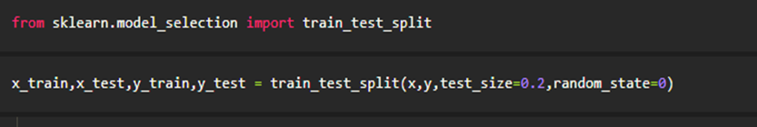
SPLITTING THE DATA INTO TRAIN AND TEST
The train-test split is a technique for evaluating the performance of a machine learning algorithm.
Train Dataset: Used to fit the machine learning model.
Test Dataset: Used to evaluate the fit machine learning model.
In general you can allocate 80% of the dataset to the training set and the remaining 20% to test.
Now split our dataset into train set and test using train test split class from sci-kit learn library

Slide 22
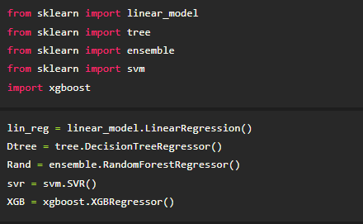
MODEL BUILDING
INITIALIZE THE MODEL

Slide 23
TRAINING AND TESTING THE MODEL
Once after splitting the data into train and test, the data should be fed to an algorithm to build a model.
There are several Machine learning algorithms to be used depending on the data you are going to process such as images, sound, text, and numerical values. The algorithms that you can choose according to the objective that you might have it may be Classification algorithms are
Linear Regression Decision Tree Regressor Random Forest Regressor KNN svm xgboost

Slide 24
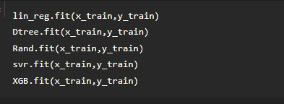
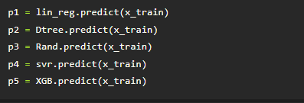
Fit the models with x_train and y_train -
Predict the y_train values and calculate the accuracy -

Slide 25
We’re going touse the x-train and y-train obtained above in the train_test_split section to train our Random forest regression model. We’re using the fit method and passing the parameters as shown below.
We are using the algorithm from Scikit learn library to build the model as shown below
Once the model is trained, it’s ready to make predictions. We can use the predict method on the model and pass x_test as a parameter to get the output a Notice that the prediction output is an array of real numbers corresponding to the input array.
After training the model, the model should be tested by using the test data which is been separated while splitting the data for checking the functionality of the model.

Slide 26
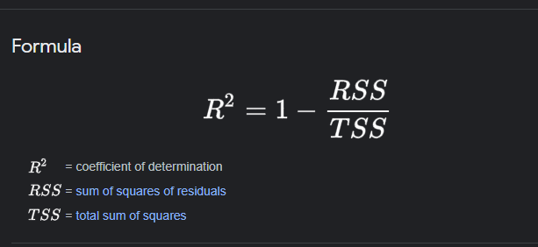
REGRESSION EVALUATION METRICS
These model evaluation techniques are used to find out the accuracy of models built in the Regression type of machine learning models. We have three types ofevaluation
R-square_score
RMSE – root mean squared error

Slide 27
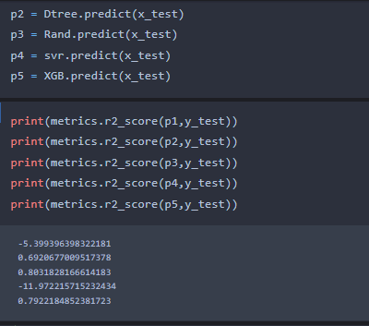
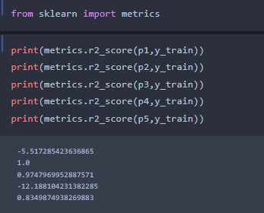
MODEL EVALUATION
It is the ratio of the number of correct predictions to the total number input samples.
Calculating the r2 score value using for all the models.

Slide 28
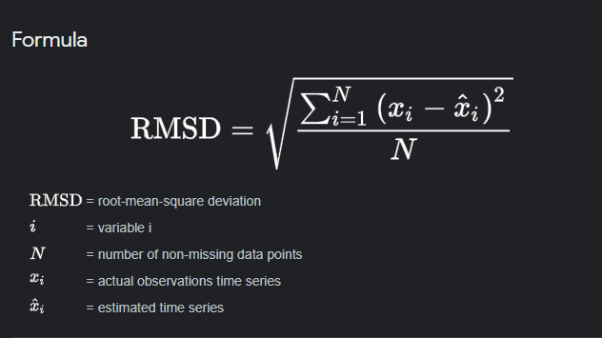
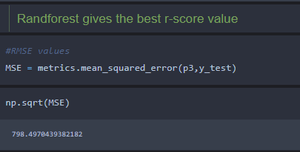
RMSE value for Random forest is very less when compared with other models, so saving the Random forest model and deploying using the following process.
After considering both r squared values of test and train we concluded that random forest regressor is giving the better value, it is able to explain the 97% of the data in train values.
Random forest gives the best r2-score, so we can select this model.
RMSE value for Random forest is very less when compared with other models, so saving the Random forest model and deploying using the following process

Slide 29
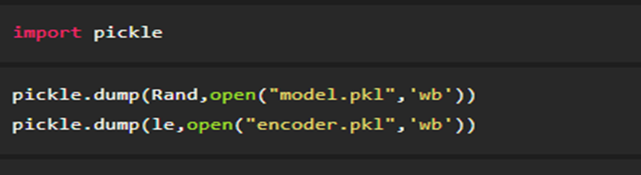
Save The Model
After building the model we have to save the model.
Pickle in Python is primarily used in serializing and deserializing a Python object structure. In other words it's the process of converting a Python object into a byte stream to store it in a file/database, maintain program state across sessions or transport data over the network. wb indicates write method and rd indicates read method.

Slide 30
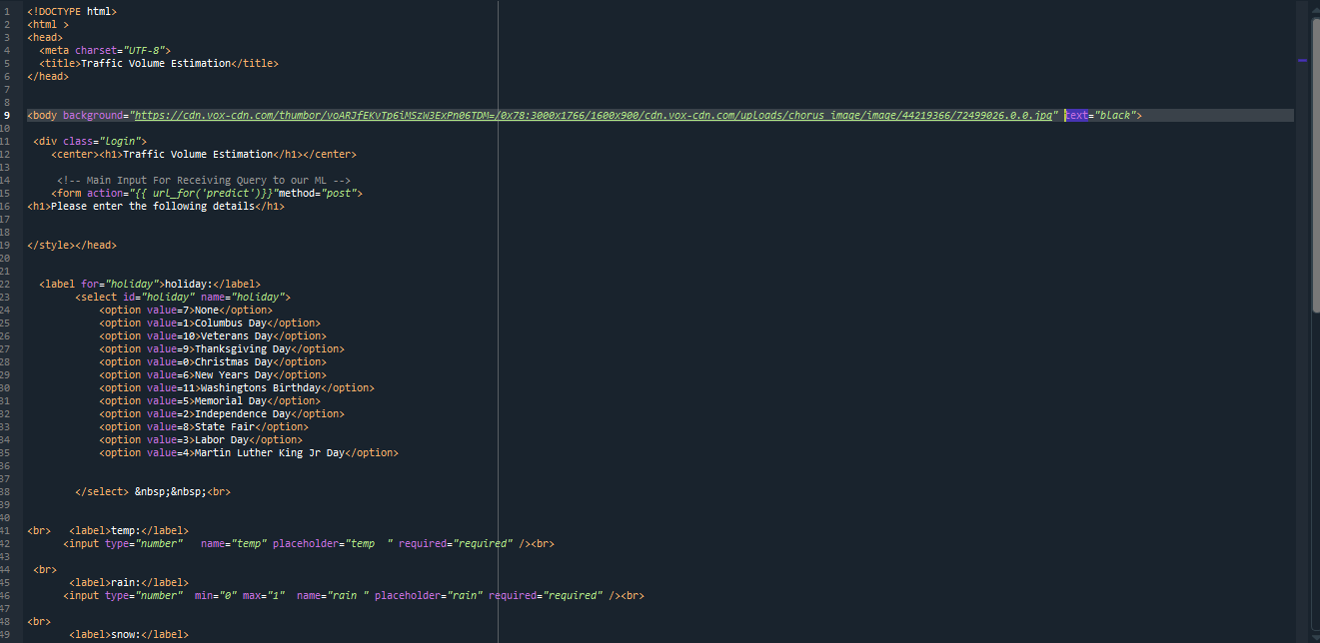
BUILD HTML CODE
1.index.html - paste the image

Slide 31
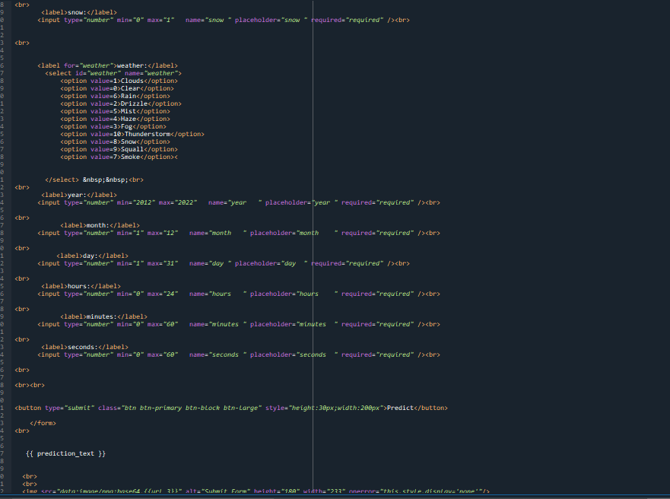
In this HTML page, we will create the front-end part of the web page. On this page, we will accept input from the user and Predict the values.
In our project we have HTML files, they are

Slide 32
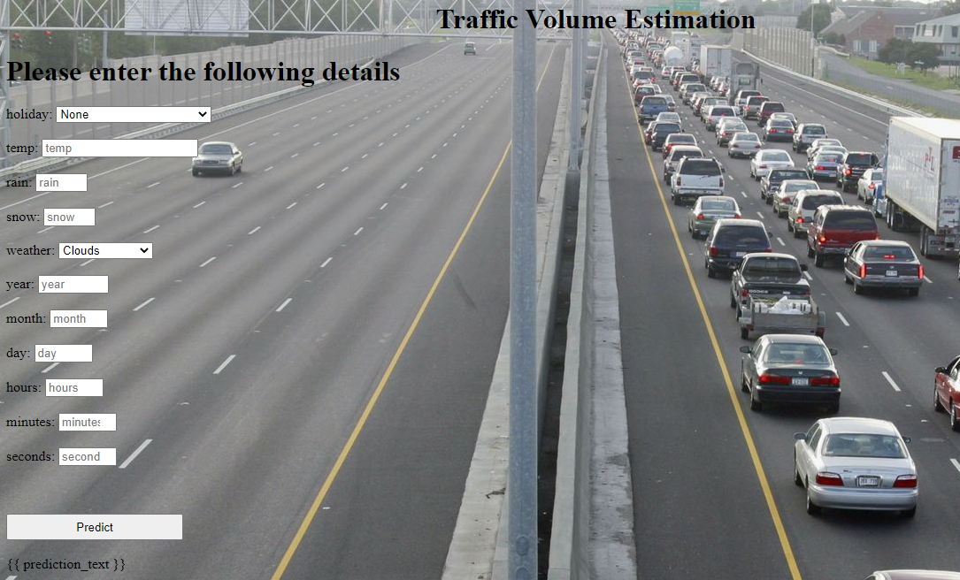
2. The HTML page looks like this-

Slide 33
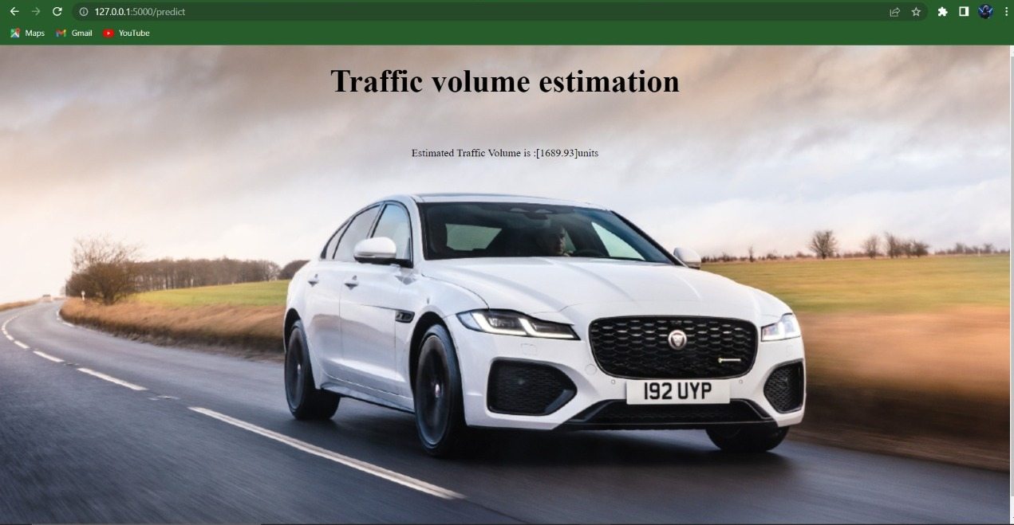
3. It will display all the input parameters and the prediction text will display the output value of the data given by the user.

Slide 34
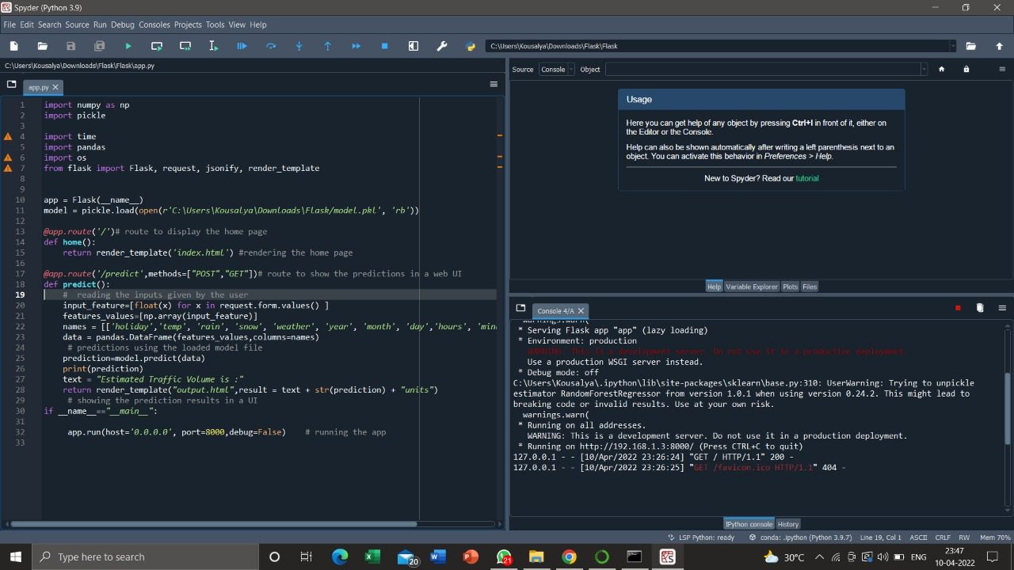
MAIN PYTHON SCRIPT
Let us build an app.py flask file which is a web framework written in python for server-side scripting. Let’s see step by step procedure for building the backend application.

Slide 35
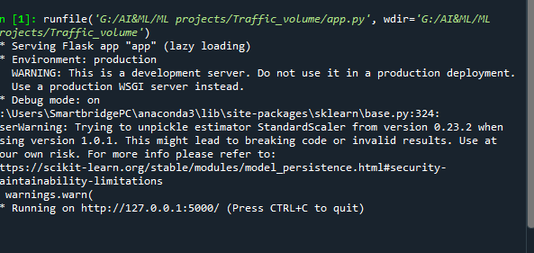
RUN THE APP
Open anaconda prompt from the start menu navigate to the folder where your python script is.
Now type the “python app.py” command
Navigate to the localhost where you can view your web page, Then it will run on local host:5000

Slide 36
CONCLUSION
Traffic volume data analysis is important for many transportation research areas, including roadway safety improvement and design, countermeasure determination, travel model calibration and validation, pavement design, and air quality compliance.
However, AADT data are more easily available for higher functional classes, and only a small percentage of low-volume roads have accurate AADT data.
Because low-volume roadways constitute a large portion of the U.S. roadway network, more studies are needed in traffic volume prediction on these roadways.

Slide 37
REFERENCES
[1] | https://smartinternz.com/Student/guided_projects/
[2] | https://www.mdpi.com/20711050/12/1/142/pdf
[3] | https://www.researchgate.net/figure/Comparison-of-the-traffic-volume-prediction-using-RMSE-with-the-AMC-short-term-NN-and_fig3_268511858
[4] | https://www.tandfonline.com/doi/full/10.1080/23742917.2017.1321891

Slide 38
THANKYOU!

